Slide 1
Chat Assistant
iBot
Yun Ma, Young Liu, Xiao Liang, Xuzhou Yin

Slide 2
Team
Team member
  Xiao Liang
  Yun Ma
  Xuzhou Yin
  Young Liu
Instructor
  Perumal N. Ramasamy
Point of contact
  Branden Bellanca
  Email: bbellanca@netjets.com
Notes:
Young

Slide 3
Project Overview
Project Management and iBot
Problem Statement
Requirements
Demo
Resources
Testing
Architecture Diagram
Notes:
Young

Slide 4
Problem Statement
Some tasks that employees do every day require cumbersome steps and unnecessary complexity.
iBot aims to solve this problem It is an intelligent bot which has Natural Language Processing Service integrated and interacts with issue & project management tools such as Jira, and continuous integration tools like Jenkins so that it helps turn inefficient steps into dialogs to increase productivity for all employees.
Notes:
Xiao

Slide 5
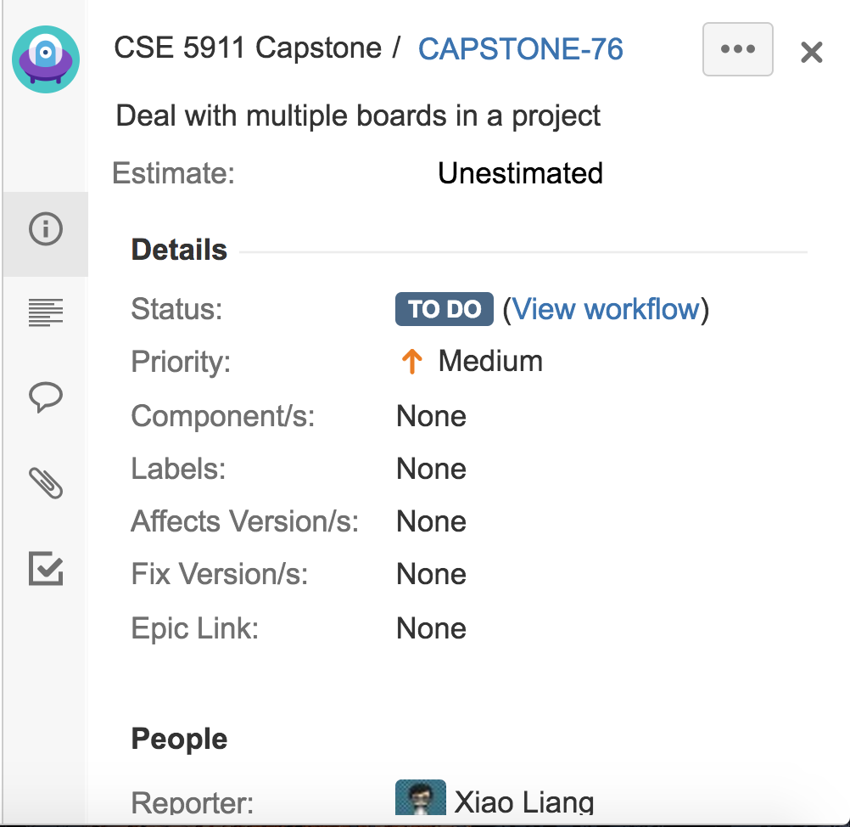
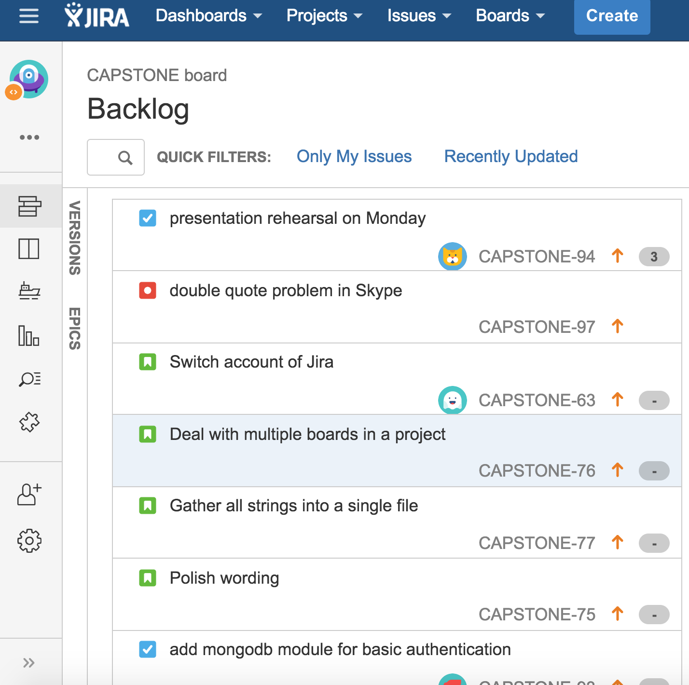
How do we conduct daily project management?
Jira issue
Jira backlog
Notes:
Young

Slide 6
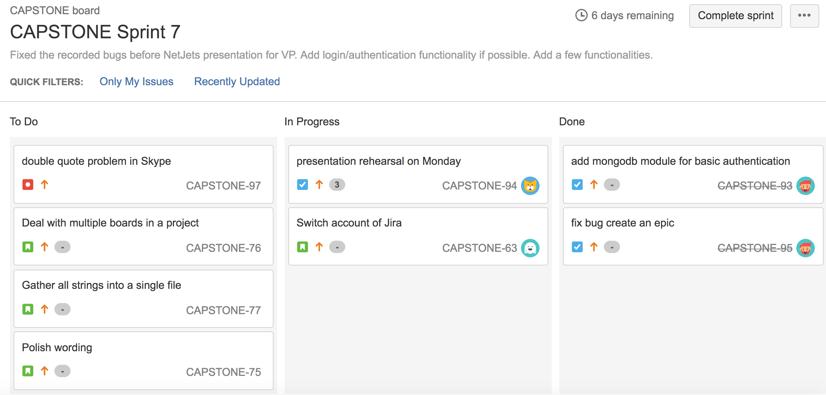
Jira sprint
Notes:
Young

Slide 7
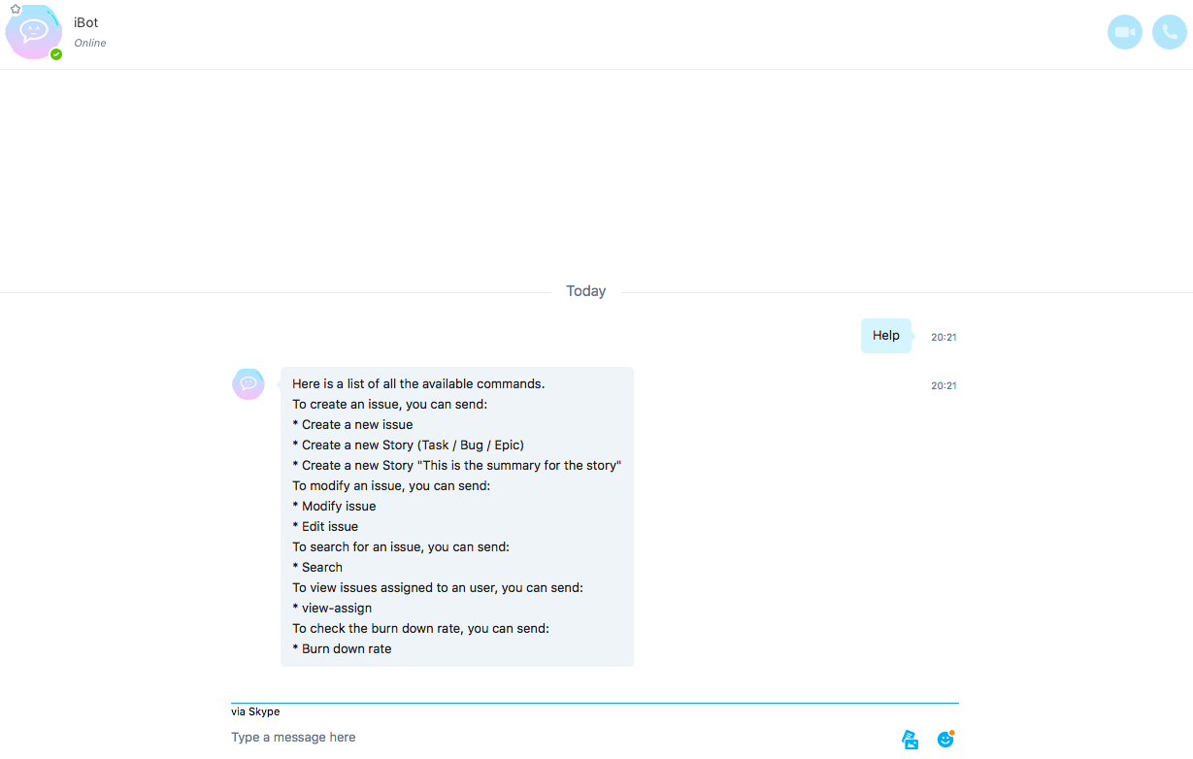
iBot on Skype
Notes:
Young

Slide 8
What is iBot?
a responsive user-oriented chatting robot
accurately understands human language
quickly interacts with Jira under the hood
largely simplifies the workflow
proudly supports multiple mainstream platforms
Notes:
Young

Slide 9
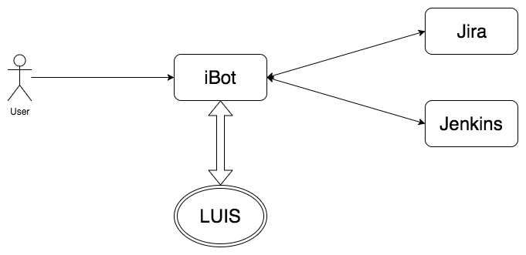
Architecture Diagram
Notes:
Xuzhou: Move it to beginning (along with problem statement) who am i, problem, example of problem, solution, what ibot is, architecture

Slide 10
Resources
Open source frameworks: BotFramework, Node.js and LUIS
Agile development supported platform: Jira
Version control & continuous integration: Git & Travis CI
Microsoft/Jira accounts
Heroku web service
Pre-defined LUIS model dataset
Documentation tools: Google Drive
Team communication tools: Google Hangouts / WeChat
Personal laptops & IDE: IntelliJ IDEA
Notes:
Xuzhou- along with architecture

Slide 11
What can iBot do exactly?
Respond when user joins
  iBot sends a greeting when user joins
Create cards/issues in Jira
  Add summary
  Move to current Sprint
Search cards/issues in Jira
  Return matched issues rendered in Rich Info cards
Assign issues to user
  Select one in members list
Change issue status
  Can choose any pre-defined status in Jira
Set priority to each task
Cancel issue creation
  Choice to cancel an issue creation process
Help command
  List of possible features
Log in / Log out
  switch between users
Other features
  Burn down rate
  Cancel at any time
Notes:
Xiao

Slide 12
DEMO

Slide 13
Log in
Functionalities
Sign in
  Username, password, Jira URL
Sign out
  Only need to enter password next time when sign in
Switch account
  Need to enter username, password and Jira URL next time when sign in

Slide 14
Functionalities
Create Issue
  Choose type
Create Story / Task / Bug / Epic / Sub-task
Add to current Sprint
  Yes / No
Create
Notes:
Xuzhou

Slide 15
Functionalities (cont.)
Modify after Create
  Add comment
  Add description
  Change status
  Assign to user
  Set priority
Direct Modify
  Search for issue first
Modify
Notes:
Xiao

Slide 16
Functionalities (cont.)
Search by keyword
  Return a list of cards
  Search failure
Search by user
  See issues assigned to user
Search
Notes:
Yun

Slide 17
Functionalities(cont.)
Ask for burn-down-rate
  Valid burn-down-rate
  Burn-down-rate failure
Others
Notes:
Young

Slide 18
Thanks!

Slide 19
Questions?
Notes:
Devops

